Slide 1


UKIEPC 2019

Slide 2
UKIEPC 2019
Introduction Starting Soon

Slide 3
UKIEPC 2019
Contest Introduction
You may: - Log in to one computer
- Start an editor of your choice
- Log in to domjudge via browser
https://domjudge.bath.ac.uk/
- Read the domjudge manual
https://domjudge.bath.ac.uk/docs
You may not: - open the problem set
- configure your editors/environment
- start to code anything - not even templates

Slide 4
UKIEPC 2019
Start time is 11:00am across all sites
Questions will become visible as soon as the contest starts.
Available Languages:
C++17 C11 Java 8 Python 2 (PyPy) Python 3
There are 13 problems - not in difficulty order
Read all of the questions!
Solutions should read from standard in, and print to standard out
Java files should have a «public static void main()»
Java files should not include «package xyz;» commands

Slide 5
Rules during contest
Only 1 computer per team, no other devices / technology
No searching the web
You may only visit the domjudge url.
https://domjudge.bath.ac.uk/
You may also visit the official documentation listed on this page
http://domjudge.bath.ac.uk/docs
Written, non-digital, material is allowed
You are allowed to use pen and paper, and to print problems or code (site permitting)

Slide 6
Judging
All judging is automated server-side by DOMjudge
Don’t print prompts eg. “Enter input:”
If in doubt, check the submission page for errors on the sample inputs.
Time limits are judged on execution time, not compile time.
If your solution fails to compile, the solution will be rejected but we won’t add penalty time.
You will be able to see compiler output by clicking on it in the submissions tab.
Memory limit: 1GiB
If you need more than this, you probably need to try another approach.

Slide 7
Judgements
CORRECT | The submission passed all tests: you solved this problem!
COMPILER-ERROR | There was an error when compiling your program. On the submission details page you can inspect the exact error. You will not receive any penalty points for this.
TIMELIMIT | Your program took longer than the maximum allowed time for this problem; therefore it has been aborted. Your program might hang in a loop, or your algorithm may need to be more efficient.
RUN-ERROR | There was an error during the execution of your program. Caused by division by zero, indexing arrays out of bounds, using excessive memory, and so on. Check that your program finishes with exit code 0!
WRONG-ANSWER | The output of your program was incorrect.
TOO-LATE | You submitted after the contest ended! Your submission is stored but will not be scored.

Slide 8
Scoring
The team with the most problems and (in case of a tie) lowest time wins!
Your time for a problem is the time at which you first correctly solved it
e.g. 13 for 13 minutes since the competition started
If your answer is wrong, you get a penalty of 20 minutes / points
e.g. 2 wrong submissions on problem X = 40 points
Solving at 90 minutes = 90 + 40 = 130 points
Penalties are only applied on problems you eventually solve
No penalty for code failing to compile

Slide 9
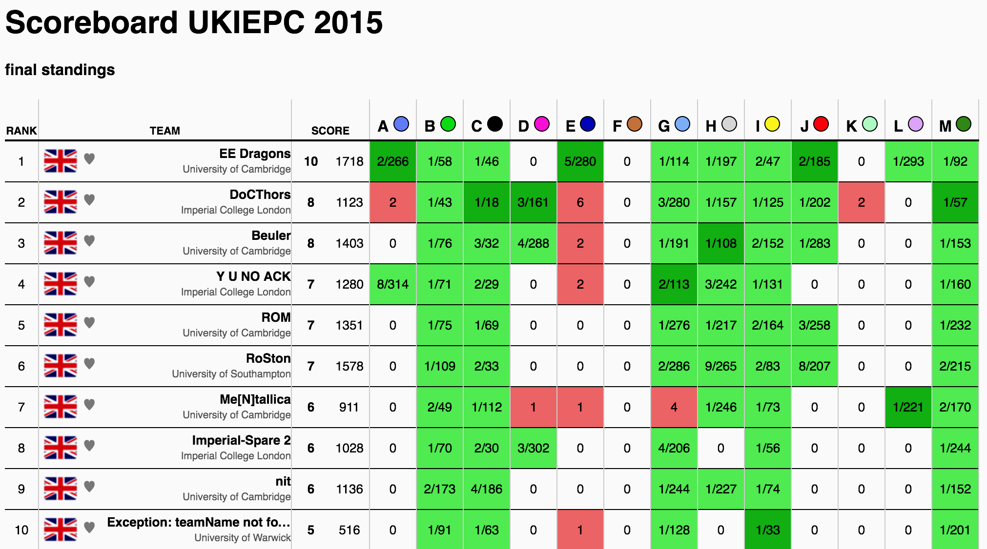
Example

Slide 10
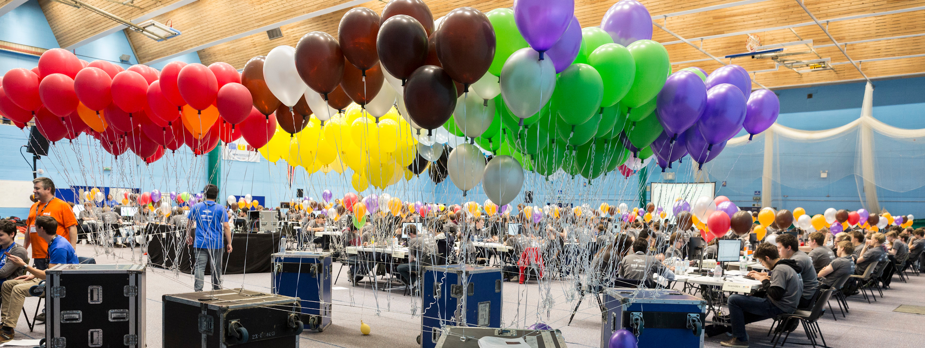
Balloons!
Some sites (optionally) give out a balloon for each task solved

Slide 11
Clarifications
All clarifications are handled through DOMjudge
Press ‘request clarification’ on the overview page.
Enter information.
You will receive an answer on the same page within 10 minutes.
Global clarifications will be sent through DOMjudge too
You will receive a notification in your browser for every new clarification.
Clarifications will not be handled via other means
do not ask your site hosts, unless about your site (e.g. where are bathrooms?)

Slide 12
End of Contest
The contest scoreboard will freeze during the last hour.
You can still see your own results on the submissions page.
The contest will end automatically after 5 hours.
Results will be announced shortly afterward.
Presented on YouTube Live
Jury members will give a short run-through of solutions.

Slide 13
Final Comments from the Jury
Example input data available with each question
Copy and Paste from this (rather than type it out)
Documentation available at https://domjudge.bath.ac.uk/docs
Available now

Slide 14
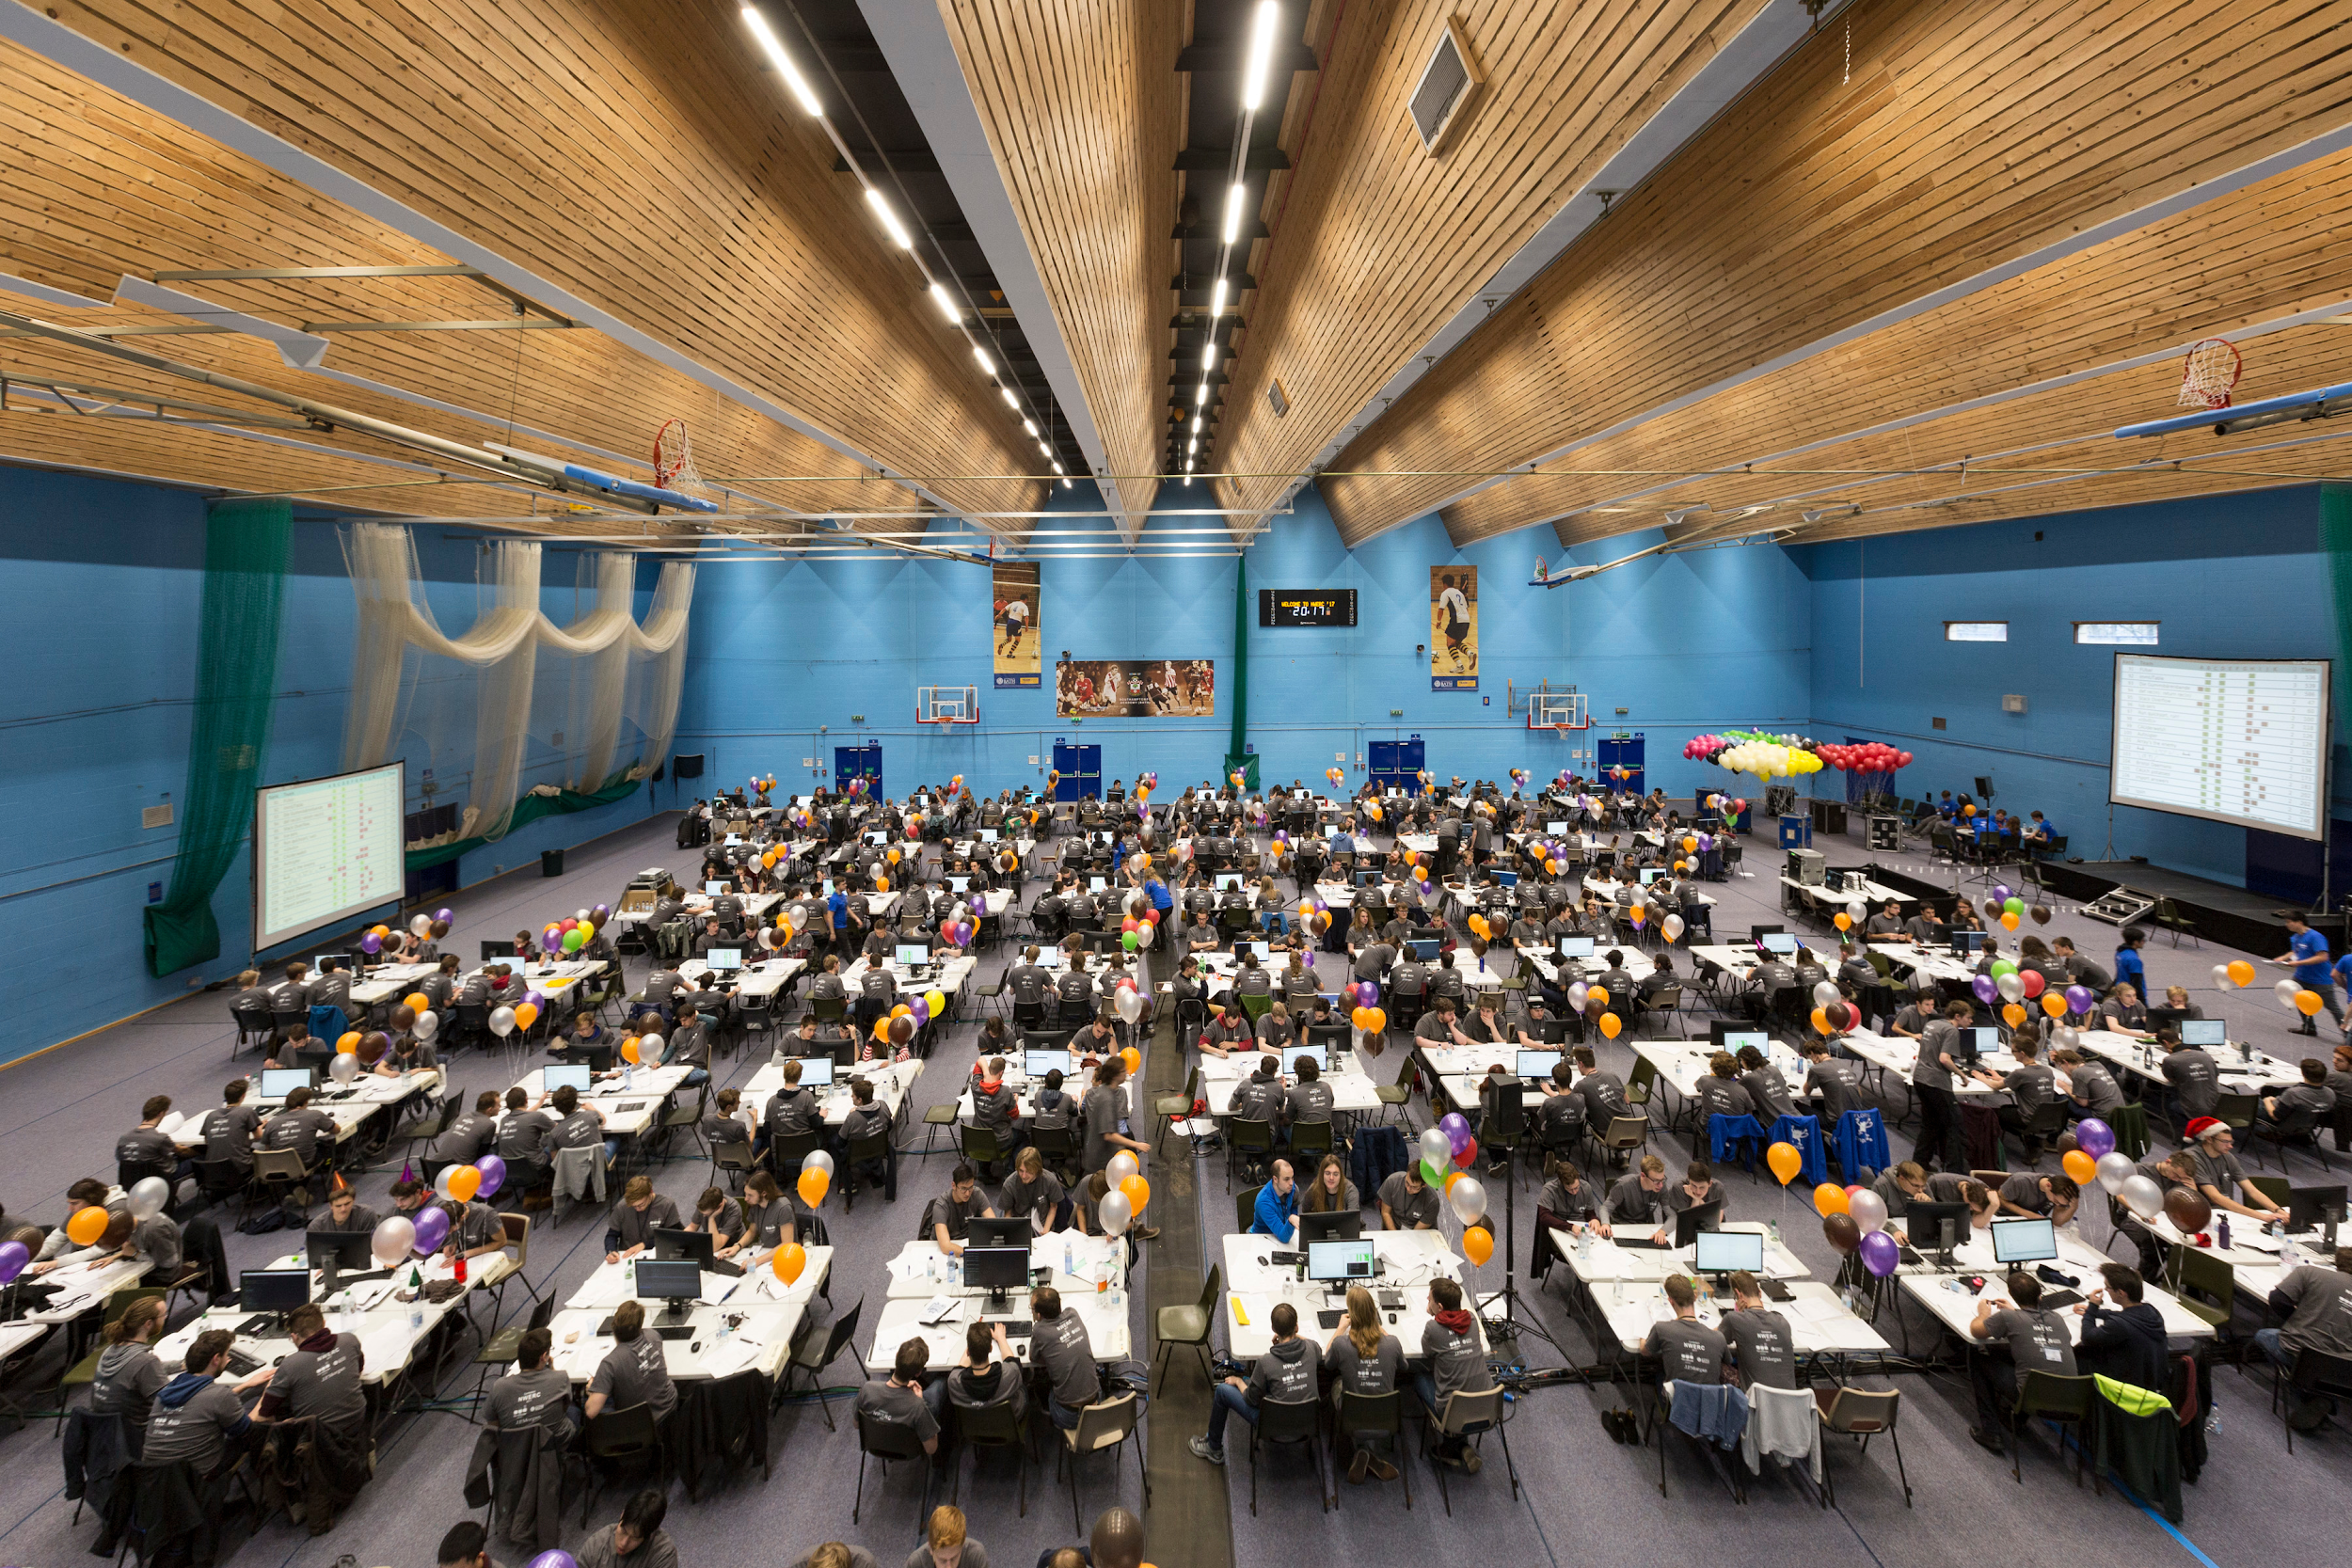
Good luck!

Slide 15
UKIEPC 2019
Results will be live streamed at ~4:15pm
Solutions at ~4:30pm

Slide 16
UKIEPC 2019
UKIEPC » NWERC
Results will be live streamed at ~4:15pm
Solutions at ~4:30pm
Dont forget to register for the Regional Contest http://nwerc.eu
1st team should be accepted. 2nd team if space.
a member of staff should email a priority to the organisers

Slide 17
UKIEPC » NWERC
Don't forget to register for the NW Europe Regional Contest!
http://nwerc.eu
The 1st and 2nd teams from every university are usually accepted
3rd teams and onward will join the waiting list
A member of staff should email a priority to the organisers

Slide 18
UKIEPC 2019
Congrats to Treeniceratops (University of Cambridge)
See you at UKIEPC 2020 (if not at NWERC 2019)!

